Slide 1
Game Dev Workshop.
By GameDevUtopia aka GDU

Slide 2
What is GDU?

Slide 3

What is GDU?
A student community focused upon game development, both on the technical and artistic angle
Primarily for the students and by the students
The club started in PICT, now is aiming to branch to other colleges
Currently branched in IIIT Kottayam, and targeting even more

Slide 4
What is
A
Video Game

Slide 5
What is a Video Game?
Video games offer interactive digital entertainment, where players engage with virtual environments using input devices to make decisions and take actions.
Games come in various genres, each with unique gameplay styles and objectives, providing a wide range of experiences from action-packed adventures to strategic simulations.
Examples of best games are : Super Mario, Candy Crush, Pong

Slide 6
Types
Of
Games

Slide 7
Kinds of Games……….
Yes there are various kinds of games ranging from shooters to racing ones to the ones with the complex stories.
Like books, music and movies, video games also has a long list of genres.
Game genres are based on the type of graphics and artstyle it posses or the mechanics it has.
And like other entertainment media, video games also mixes two or more genres
For example, GTA V is an open world game and also is story driven

Slide 8
What are
Genres of
Video Games

Slide 9
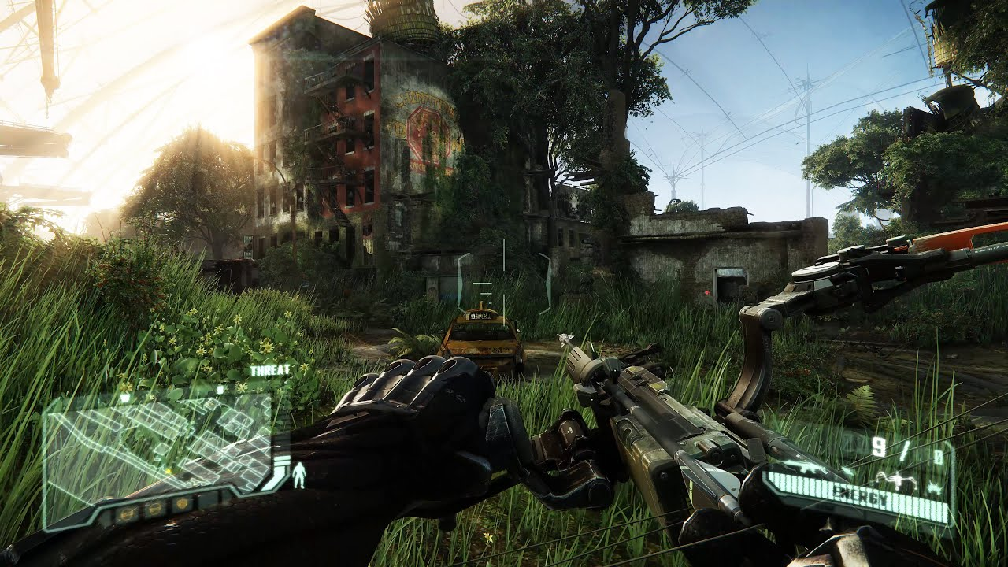
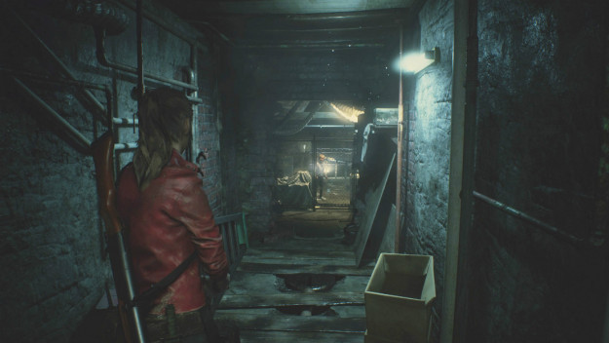
<< FPS : First Person Shooter
Eg : Crysis 3
Third Person >>
Eg : Resident Evil 2 Remake

Slide 10
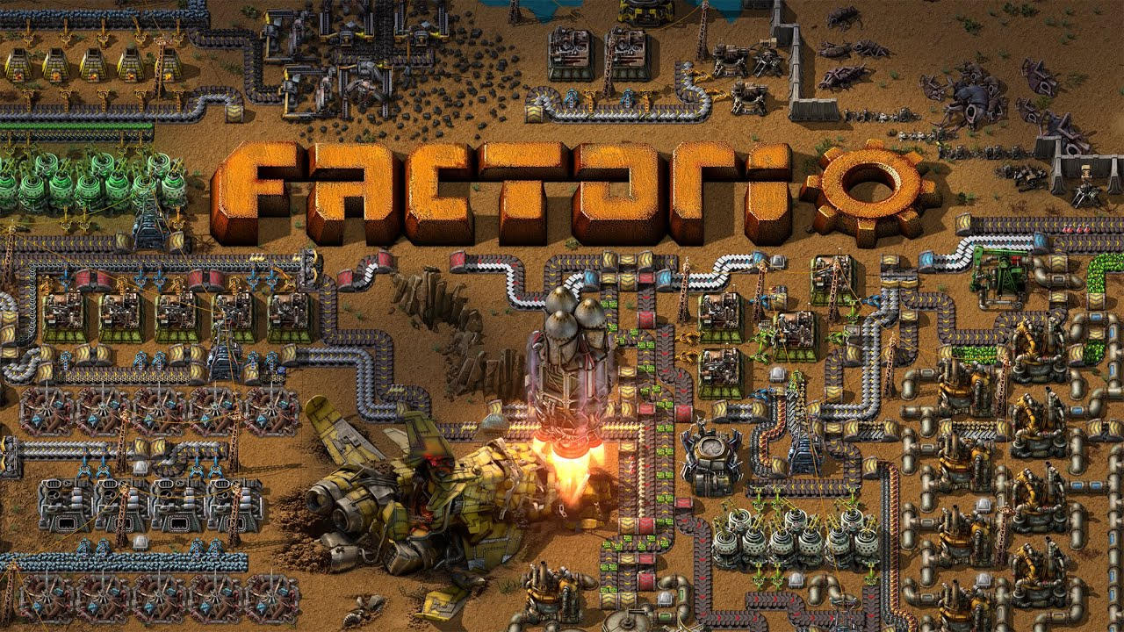
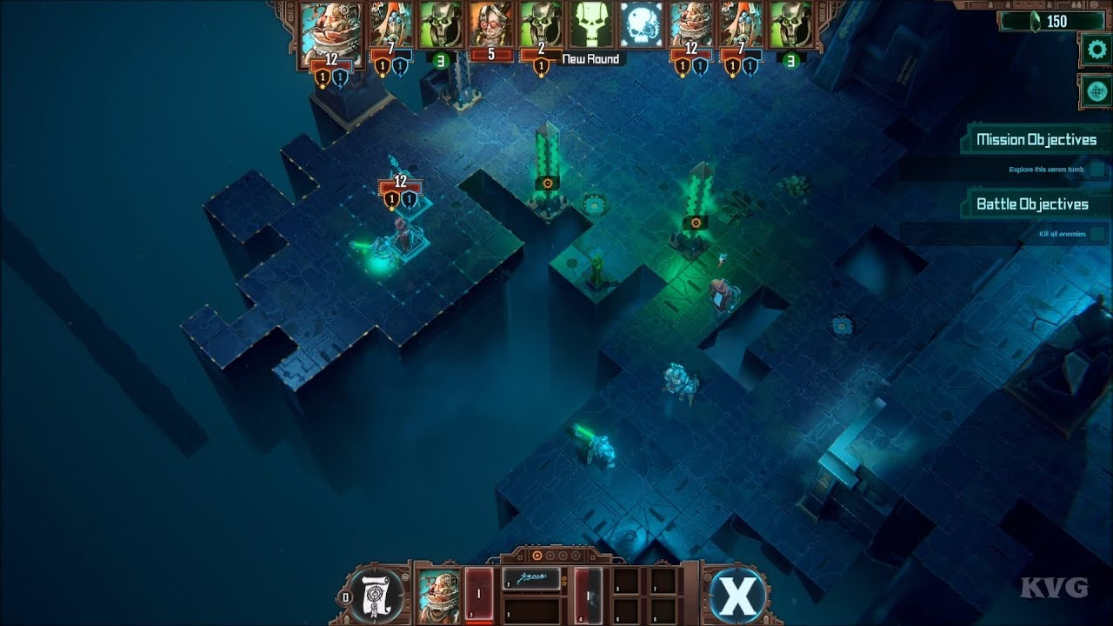
<< Strategy
Eg : Factorio
Turn Based >>
Eg : Mechanicus

Slide 11
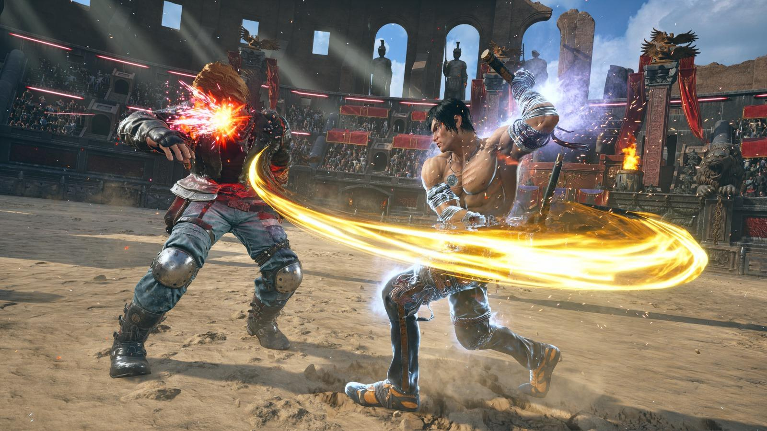
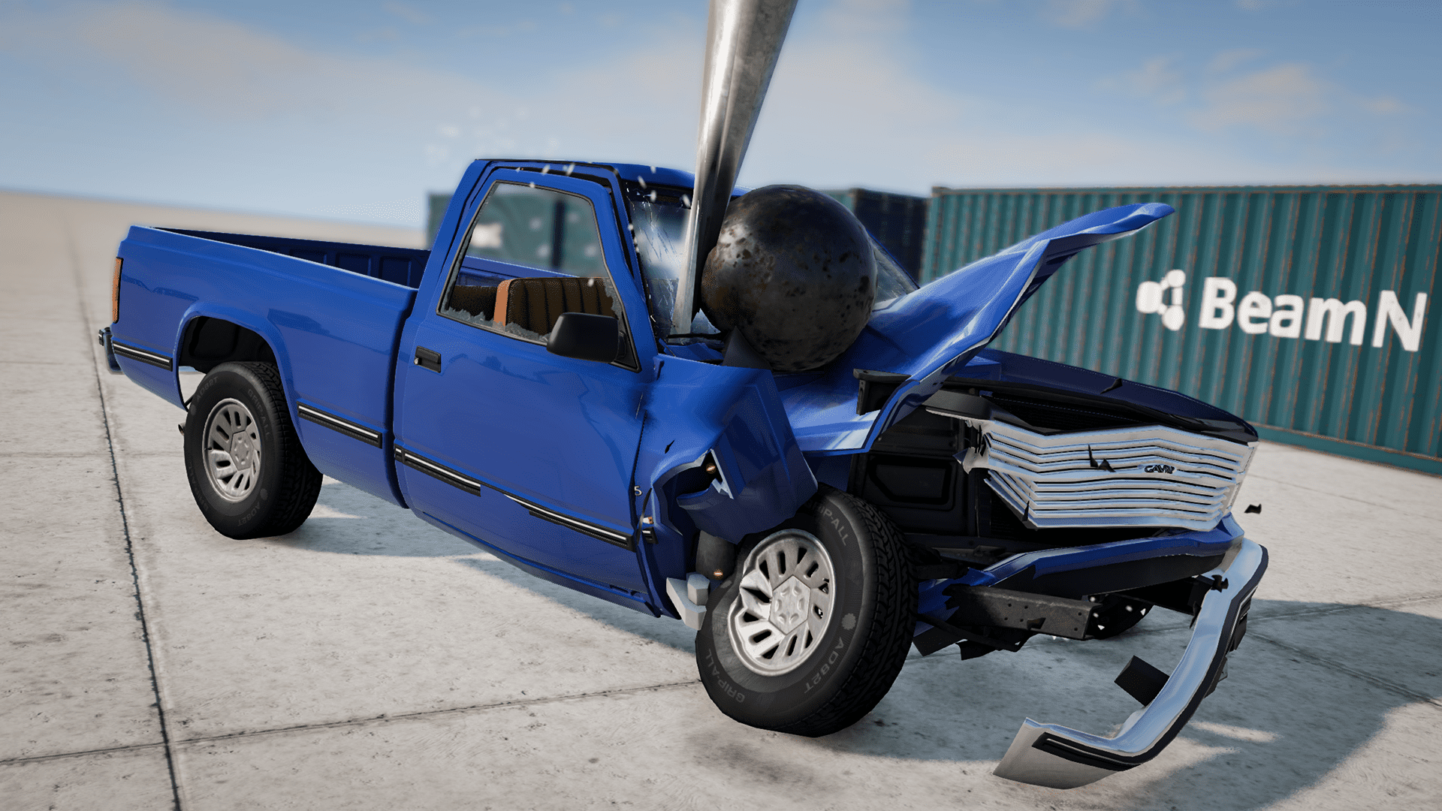
<< Fighting
Eg : Tekken 8
Simulation >>
Eg : BeamNG.Drive

Slide 12
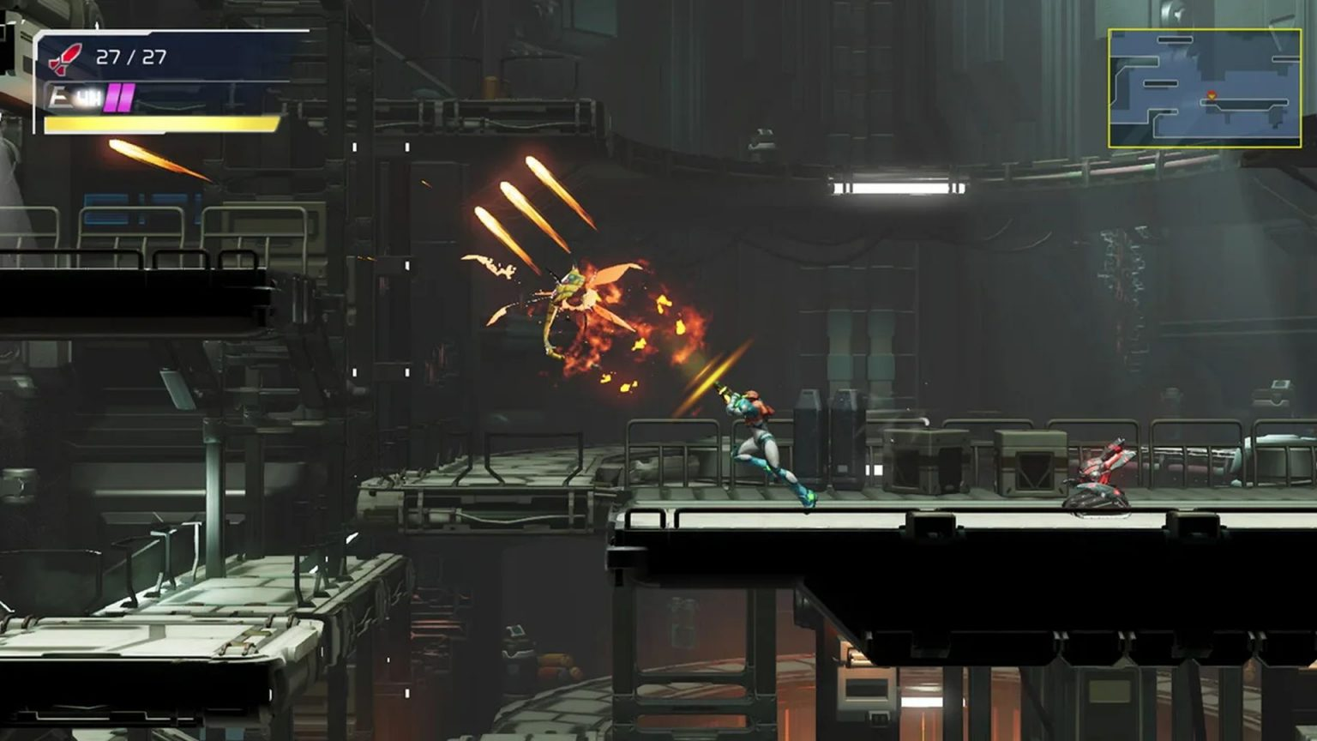
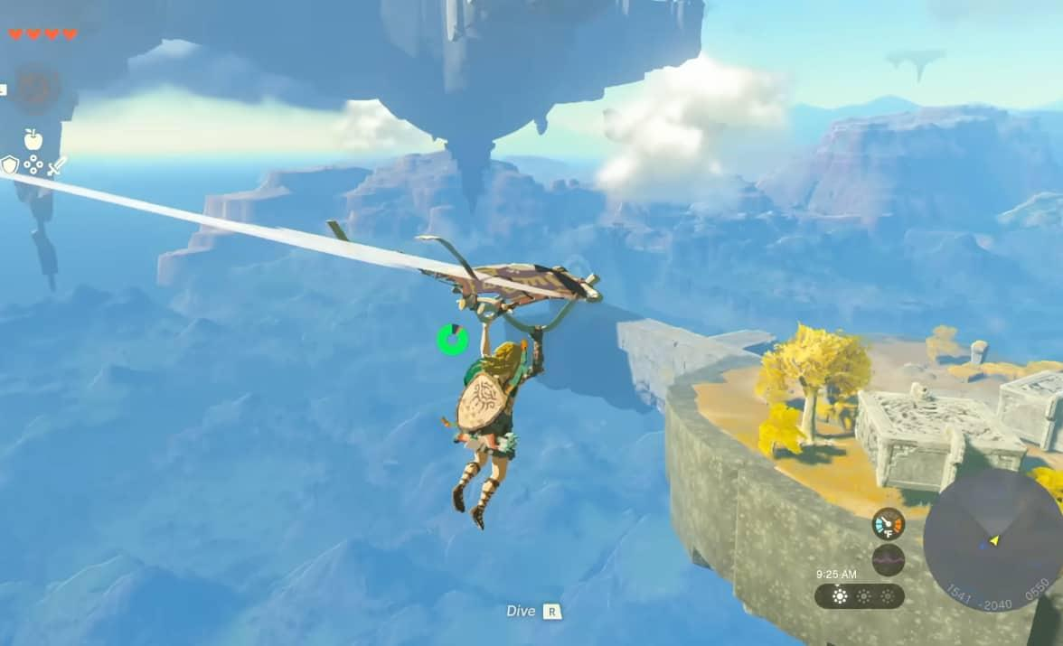
<< Platformer
Eg : Metroid :: Dread
RPG : Role Playing Game >>
Eg : Zelda : Tears Of Kingdome

Slide 13
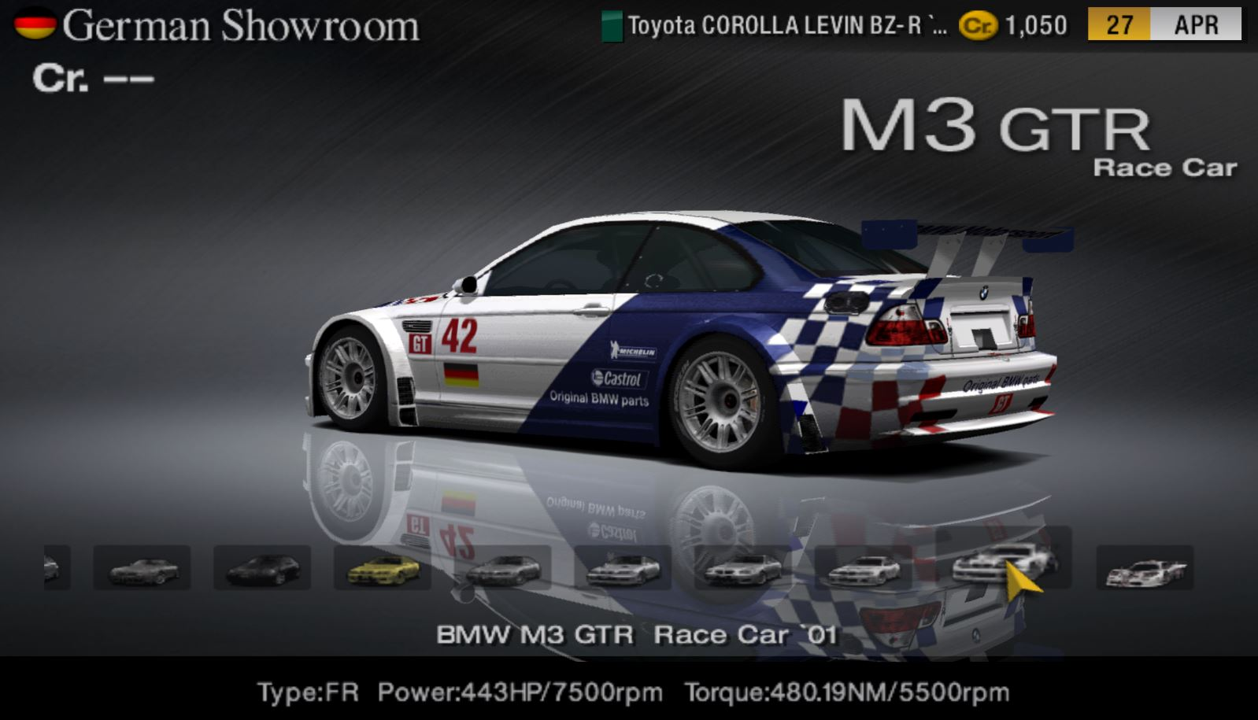

<< Racing
Eg : Gran Turismo 4
Survival >>
Eg : Sons Of The Forest

Slide 14
Frameworks Vs Engines

Slide 15
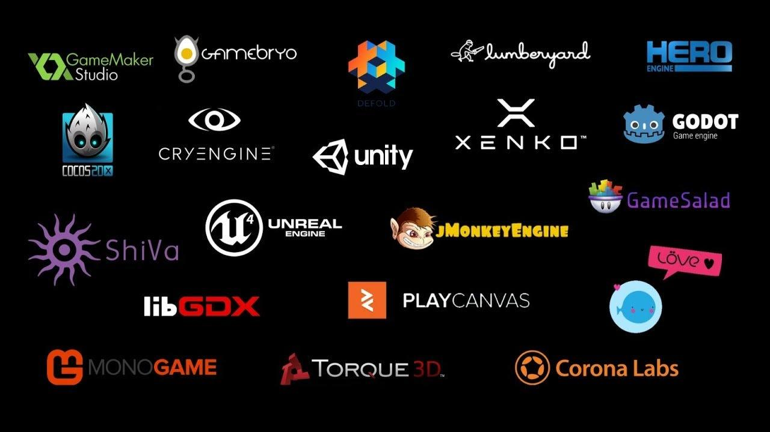

Slide 16
Game Engines
Game Engines are comprehensive suites of tools and technologies that provide a complete environment for game development.
It typically includes features like Rendering, Physics, Audio, Node Scripting, and Asset Management.
Examples of game engines include Unity, Unreal Engine, and Godot.

Slide 17
Game Frameworks
Game Frameworks are collections of libraries and tools that simplify game development while remaining lightweight, customizable, and flexible.
They provide you with a foundation you can work with while creating your games. You can also learn more about the underlying principles and techniques of game development.
Examples: Pygame, Phaser, and Love2D.

Slide 18

Which One To
Choose ?

Slide 19
Flexibility against Convenience
A game framework gives you more control and flexibility over how you use these components, but it also requires more coding and integration work from you.
A game engine provides a complete solution for creating games, including a graphical user interface, a scene editor, an asset manager, a scripting language, etc. It handles most of the technical details for you, and lets you focus on the design and content of your game.
However, you also have to follow the conventions and limitations of the engine, and it may be harder to modify or extend its features.

Slide 20
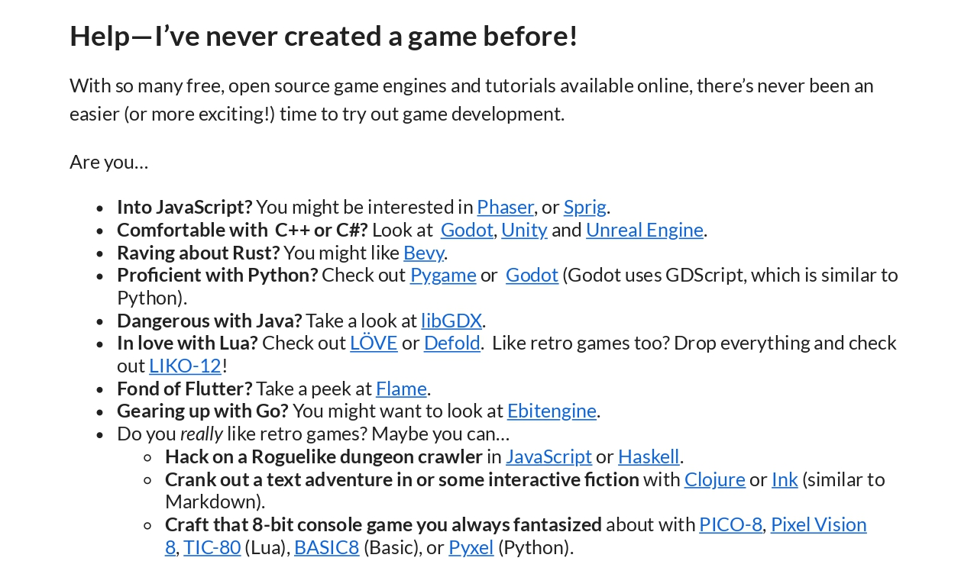

Slide 21
We Choose Love2d

Slide 22
What is Love2d
Fast 2D Game Development Framework written in C++.
Uses Lua as its Scripting Language.
Contains Modules for graphics, keyboard input, math, audio, physics and much more.
Completely Free and Open Source. Size approx 10-15 Mb.
Portable to all Major Desktop and Android/IOS.
Great for prototyping.

Slide 23
What is Lua ?
Fast, Multi-paradigm scripting Language, designed By Computer Scientists in Brazil.
Interpreted Language.
Lua is cross-platform, since the interpreter is written in ANSI C (Highly Portable).
Lua when used with JIT, widely considered as fastest scripting language in world. (Beats PyPy Node).
Embedded Language.

Slide 24
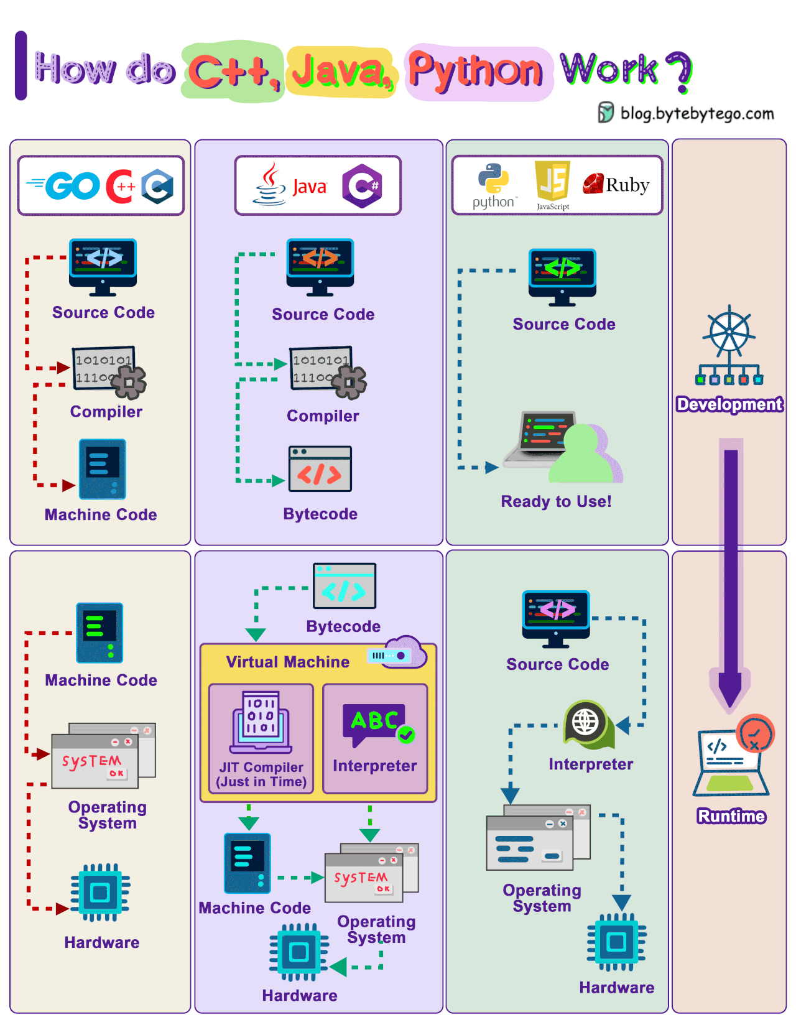

Slide 25
Compiled Vs Interpreted
A compiler and an interpreter are both programs that translate source code into machine code. However, they do this in different ways.
A compiler translates the entire source code program into machine code before the program is executed. This process is called compilation. Once the program has been compiled, it can be executed without the compiler.
An interpreter translates the source code line by line as the program is executed. This process is called interpretation. The interpreter reads each line of source code, translates it into machine code, and then executes it.

Slide 26

Lua Scripting Quick Overview
https://github.com/pohka/Lua-Beginners-Guide

Slide 27
Part One Done :)

Slide 28
Love2d
For the workshop we will be using Love2d

Slide 29
Demo Of Game

Slide 30
3 Main Functions
love.load()
This function is used for initializing our game state at the very beginning of program execution. Whatever code we put here will be executed once at the very beginning of the program.
love.update(dt)
This function is called by LÖVE at each frame of program execution; dt (i.e., DeltaTime) will be the elapsed time in seconds since the last frame, and we can use this to scale any changes in our game for even behavior across frame rates.
love.draw()
This function is also called at each frame by LÖVE. It is called after the update step completes so that we can draw things to the screen once they’ve changed.

Slide 31
Co-ordinate
System

Slide 32
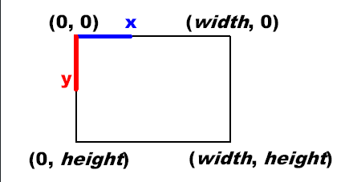
2D Coordinate System
Slightly different from the traditional coordinate system you might’ve used in math class, the 2D coordinate system we’re referring to here is a system in which objects have an X and Y coordinate (X, Y). Are drawn accordingly, with (0,0) being the top-left of the system. This means positive directions moving down and to the right, while negative directions move up and to the left.

Slide 33
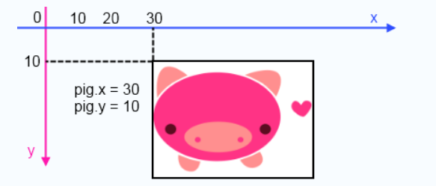

Slide 34
Delta Time
Delta time is the time that has passed between the previous and the current update. So on computer A, which runs with 100 fps, delta time on average would be 1 / 100, which is 0.01.

Slide 35
Delta Time

Slide 36
Comparison
Without Delta Time: let's say that Computer A runs with 100 fps (frames per second), and Computer B runs with 200 fps.
Computer A: 100 x 5 = 500 Computer B: 200 x 5 = 1000
With Delta Time: So on computer A, 100 fps, delta time on average would be 1 / 100, which is 0.01.
On computer B, delta time would be 1 / 200, which is 0.005. Computer A: 100 x 5 x 0.01 = 5 Computer B: 200 x 5 x 0.005 = 5

Slide 37
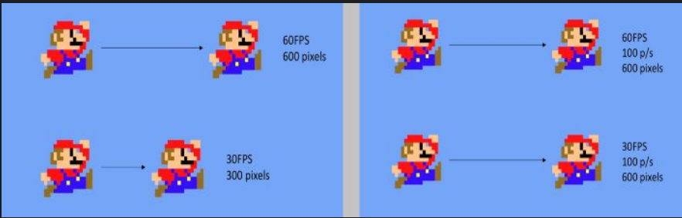

Slide 38
Delta Time
Demonstration

Slide 39
Hands On Implementation.

Slide 40
Player Script Movement Enemies

Slide 41
OOP Concepts

Slide 42
Classes And Objects
A class is a blueprint that defines the properties and behaviour of similar objects or entities. Each object is an instance of a class that has a set of properties and behaviors which are defined in the class and are associated with the objects.

Slide 43
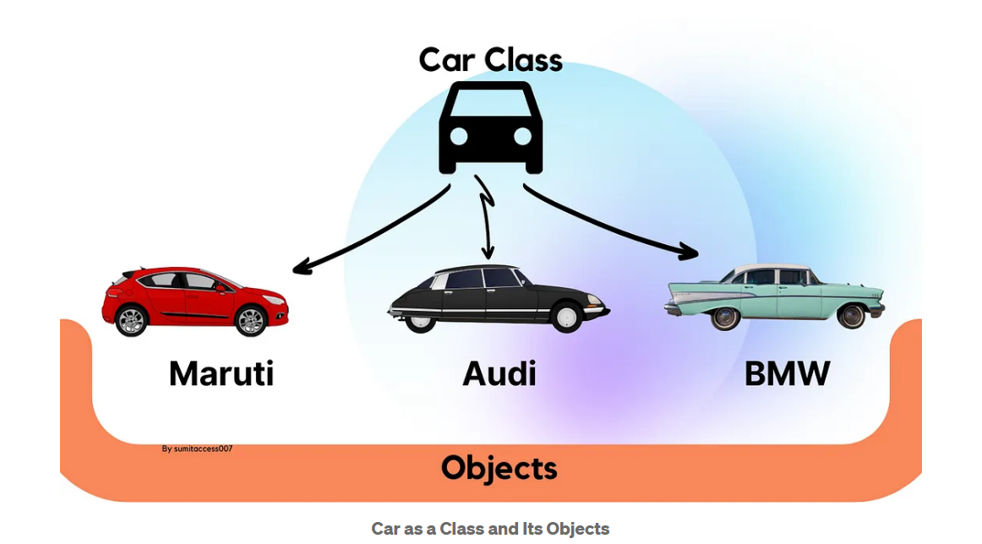

Slide 44
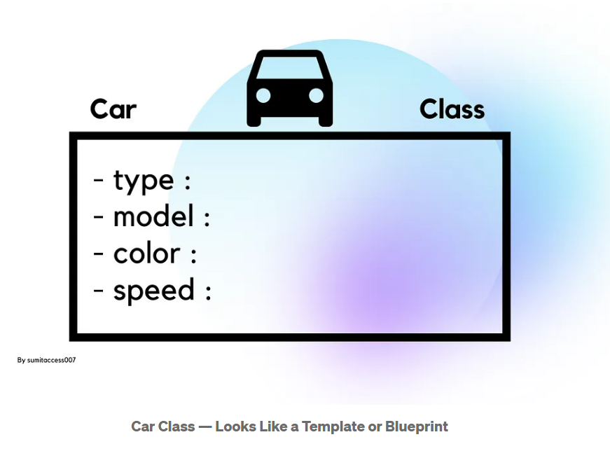

Slide 45
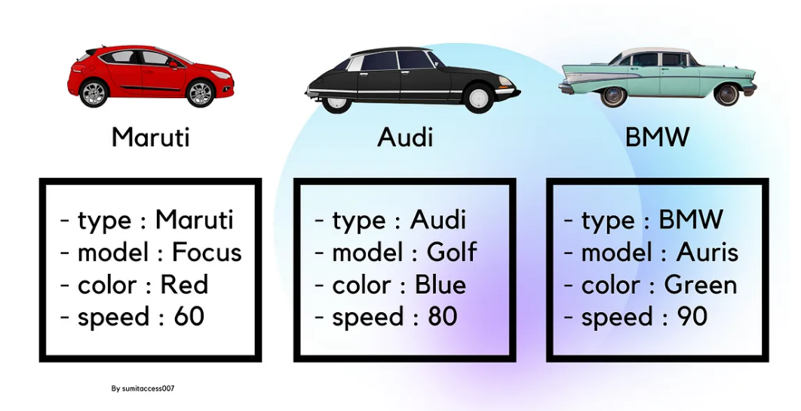

Slide 46
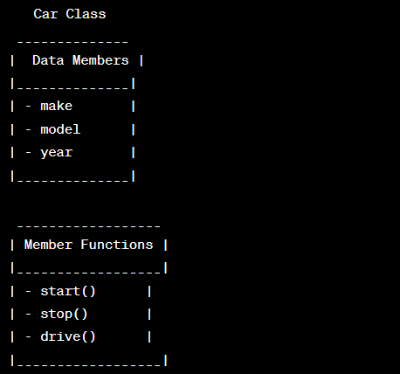

Slide 47
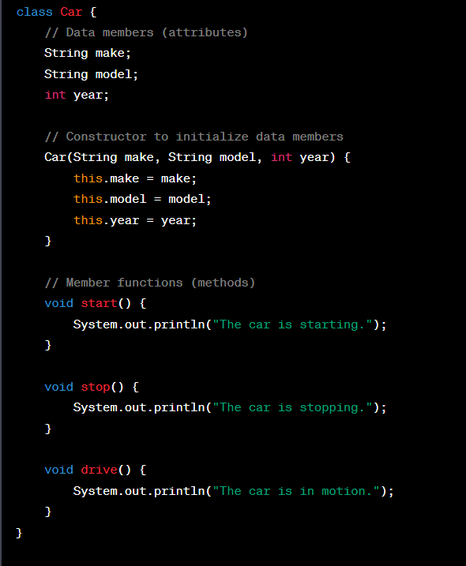
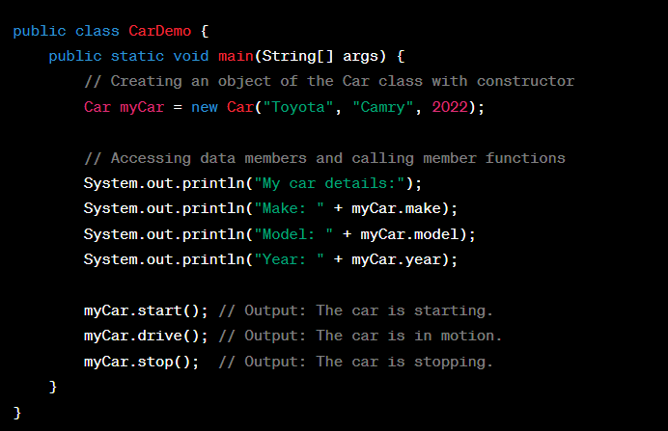

Slide 48
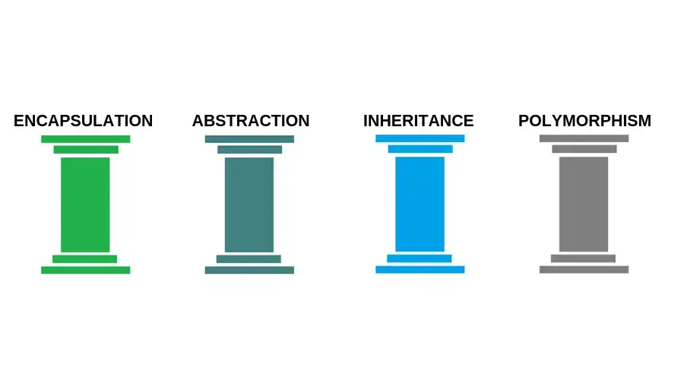

Slide 49
Abstraction
Abstraction is the process of hiding the internal details of an application. Your car is a great example of abstraction. You can start a car by turning the key or pressing the start button. You don’t need to know how the engine is getting started, what all components your car has. The car internal implementation and complex logic is completely hidden from the user.

Slide 50
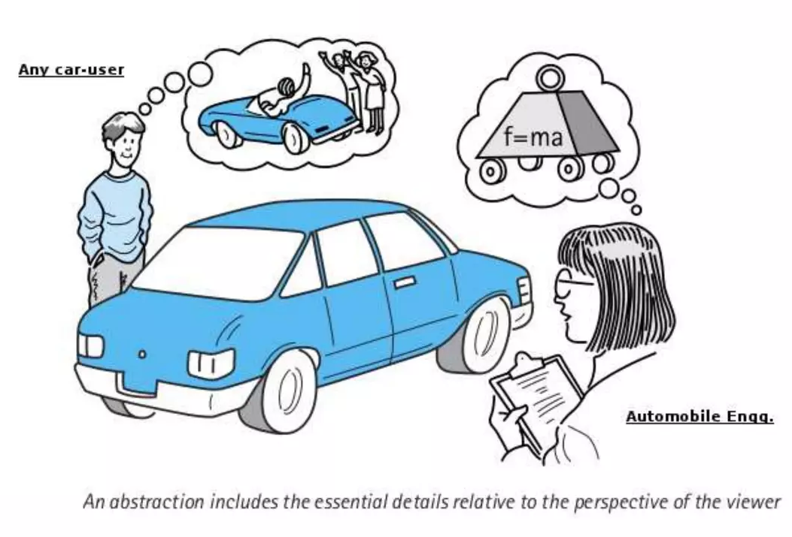

Slide 51
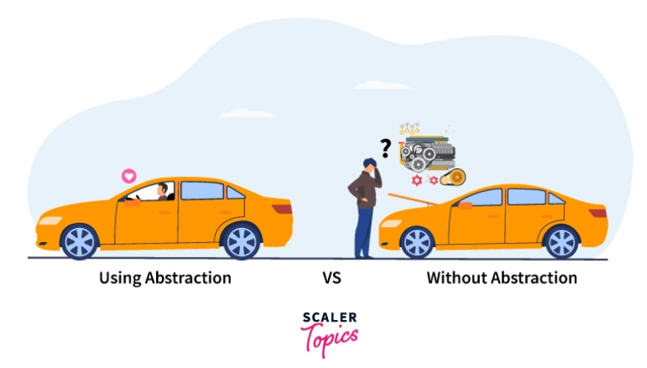

Slide 52
Abstraction in C++ and Java
In Java: Abstraction is achieved by interfaces and abstract classes. We can achieve 100% abstraction using interfaces. In C++: Abstraction can also be achieved using header files as we hide the function's implementation in header files. We could use that same function in our program without knowing its inside workings. Sort(), for example, is used to sort an array, a list, or a collection of items, and we know that if we give a container to sort, it will sort it, but we don't know which sorting algorithm it uses to sort that container.

Slide 53
ADT
An Abstract Data Type (ADT) is a programming concept that defines a high-level view of a data structure, without specifying the implementation details. Examples of abstract data type in data structures are List, Stack, Queue, etc.

Slide 54
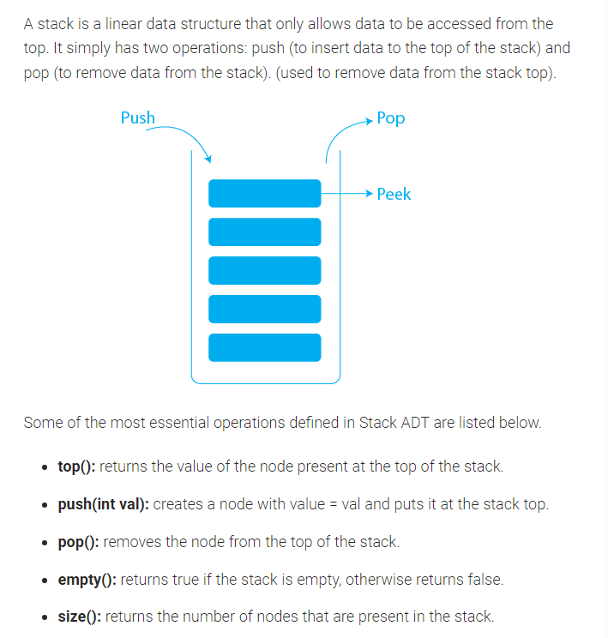

Slide 55
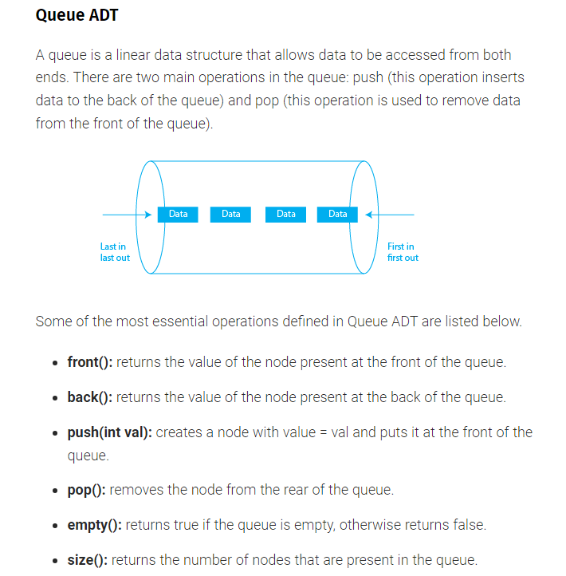

Slide 56
Encapsulation
Data Encapsulation can be defined as wrapping the code or methods(properties) and the related fields or variables together as a single unit. In object-oriented programming, we call this single unit - a class, interface, etc.

Slide 57
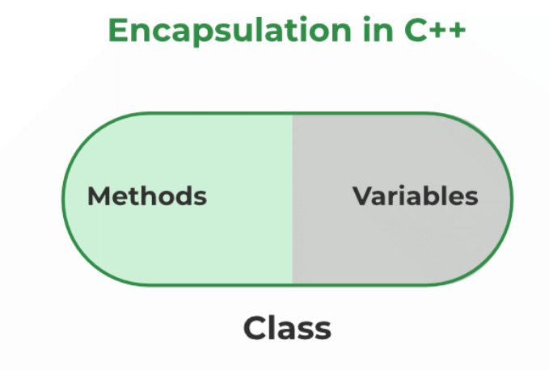

Slide 58
Encapsulation in Java : Use the private access modifier to declare all variables/fields of class as private.
Define public getter and setter methods to read and modify/set the values of the above said fields. In C++, encapsulation can be implemented using classes and access modifiers.

Slide 59
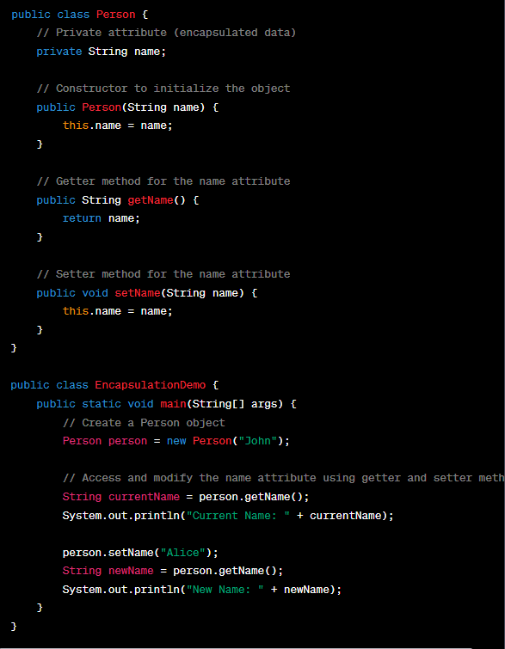

Slide 60
Polymorphism
Polymorphism is the ability of an entity to take several forms. In object-oriented programming, it refers to the ability of an object (or a reference to an object) to take different forms of objects.
It allows a common data-gathering message to be sent to each class.
Polymorphism encourages called as ‘extendibility’ which means an object or a class can have it’s uses extended.

Slide 61
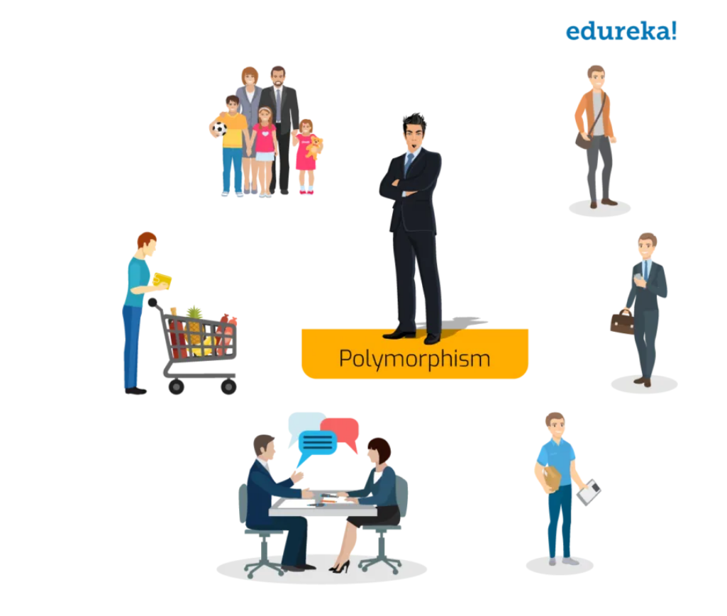

Slide 62
How it is Achieved
Polymorphism in object-oriented programming is achieved through the following mechanisms:
Method Overloading: Multiple methods in a class with the same name but different parameter lists (number or types of parameters).
Method Overriding: Method overriding occurs when a subclass provides a specific implementation for a method that is already defined in its superclass.

Slide 63
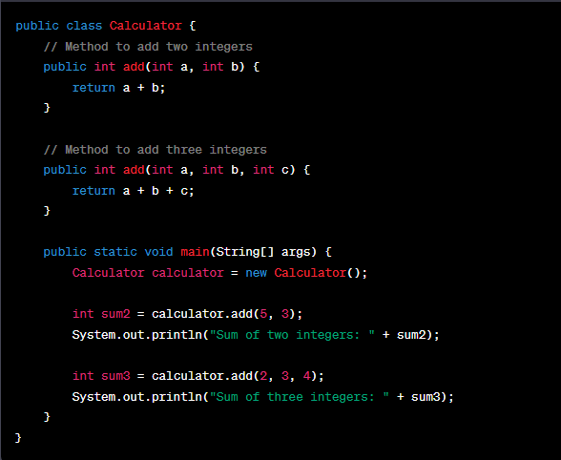
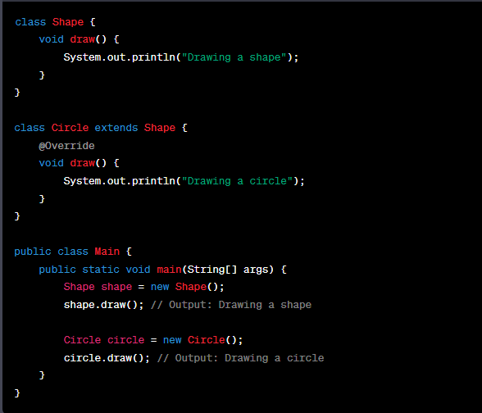

Slide 64
Inheritance
Just like in real life, where individuals inherit wealth, responsibilities, and characteristics from their parents. Inheritance in object-oriented programming (OOP) enables the reuse of code and facilitates the creation of powerful software systems. Inheritance in OOP => What a class derives from another class. The child class will inherit all the public and protected properties and methods from the parent class. In addition, it can have its own properties and methods.

Slide 65
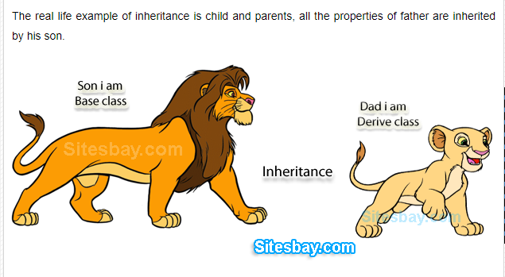
Who are the characters in this picture :

Slide 66
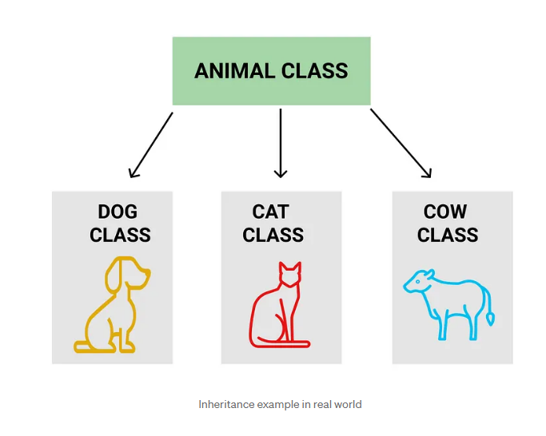
Notes:
Just

Slide 67
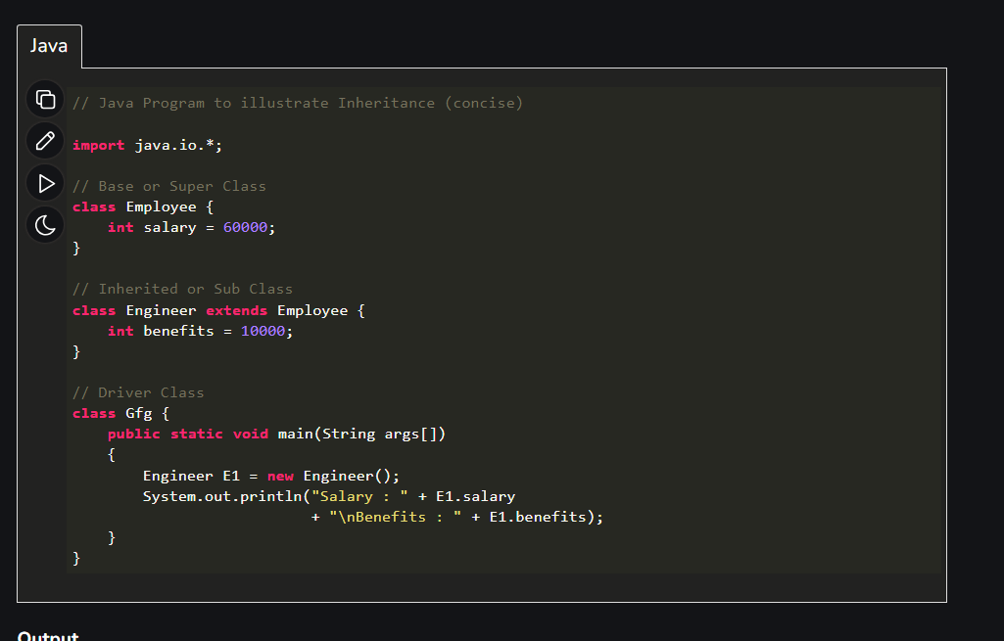

Slide 68
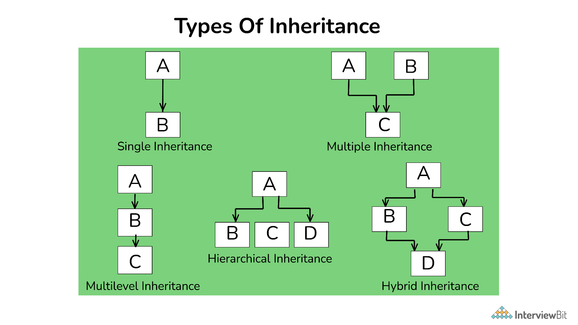

Slide 69
Hands On Implementation.

Slide 70


Slide 71
Parallax Effect
Parallax Scrolling is an important concept in game development. It refers to the illusion of movement given two frames of reference that are moving at different rates.
For a real life example, consider riding in a car and looking out the window. Suppose you’re driving near mountains and there are railings on the side of the road. You might notice that the railings may appear to be moving much more quickly in your frame of vision than the mountains.
We want to simulate this behavior in our game with the ground and background to give the appearance of motion.

Slide 72
Hands On Implementation.

Slide 73
Sprite Animation
Sprite animation is a technique used in game development to make objects or characters in a game appear to move. It works by showing a series of images, called sprites, one after the other at a rapid pace. This creates the illusion of motion, just like in old-fashioned flipbooks

Slide 74
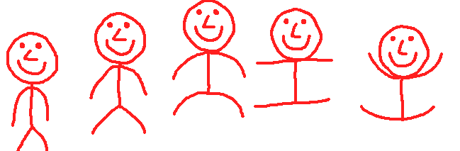

Slide 75


Slide 76
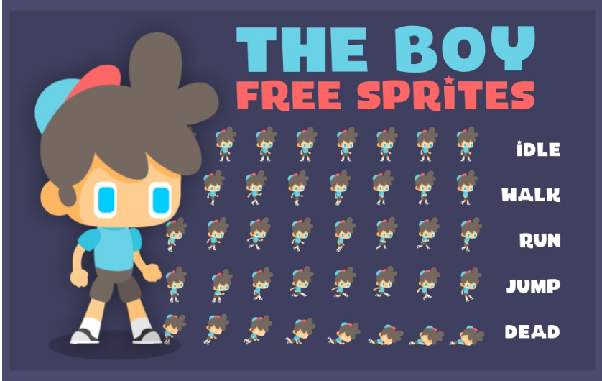

Slide 77
Hands On Implementation.

Slide 78
Axis Aligned Bounding Box
AABB Collision Detection relies on all colliding entities to have “axis-aligned bounding boxes”, which simply means their collision boxes contain no rotation in our world space, which allows us to use a simple math formula to test for collision. As with 2D collision detection, axis-aligned bounding boxes (AABB) are the quickest algorithm to determine whether the two game entities are overlapping or not.

Slide 79
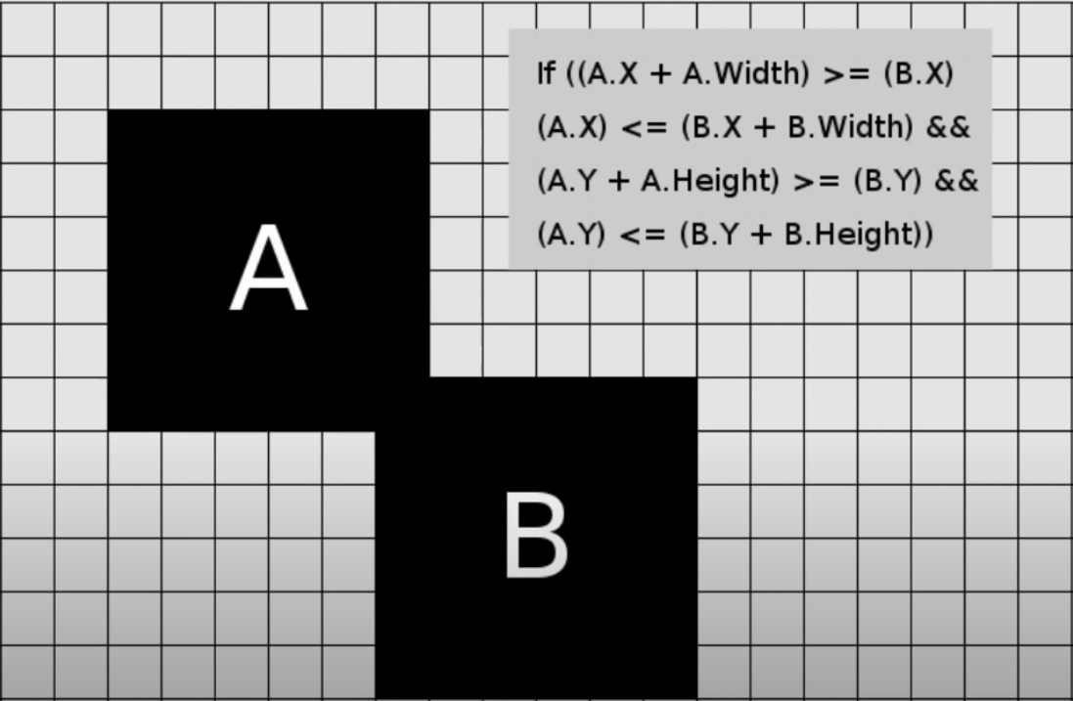

Slide 80
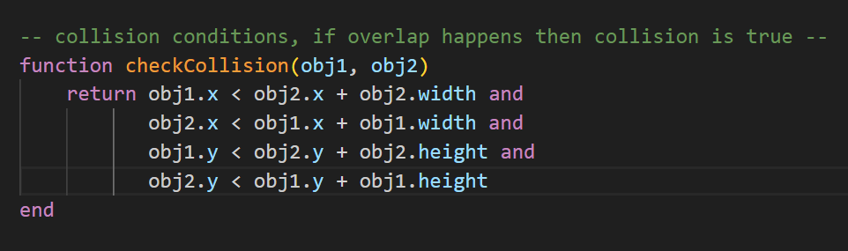

Slide 81
Hands On Implementation.

Slide 82
Player Logic Chase:
All you need to know is: angle = math.atan2(target_y - object_y, target_x - object_x) math.atan2 returns an angle in radians.
The returned angle is between -3.14 and 3.14. In Lua we can get π by using math.pi.

Slide 83


Slide 84
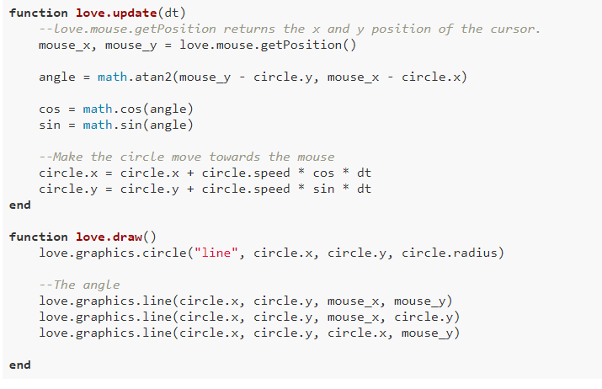

Slide 85
Hands On Implementation.

Slide 86
Write-on effect with substring
A substring is a contiguous sequence of characters within a longer string. String "Hello, World!" and you want to extract the substring "World" from it, "World" would be considered a substring of the original string.

Slide 87
Hands On Implementation.

Slide 88

Extra Features
Audio in LOVE2D
Camera Handling using Hump
Awesome Love2D Libraries

Slide 89
Overview of
GameDev
(Tech/Non tech)

Slide 90
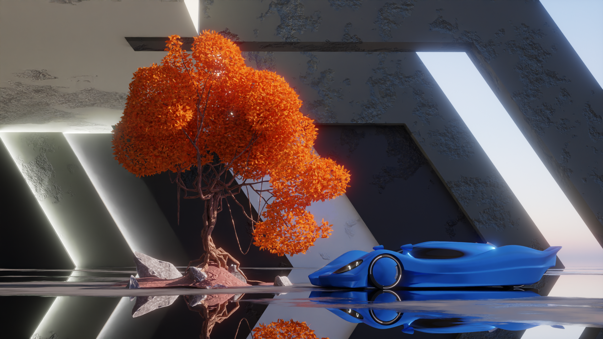

Slide 91
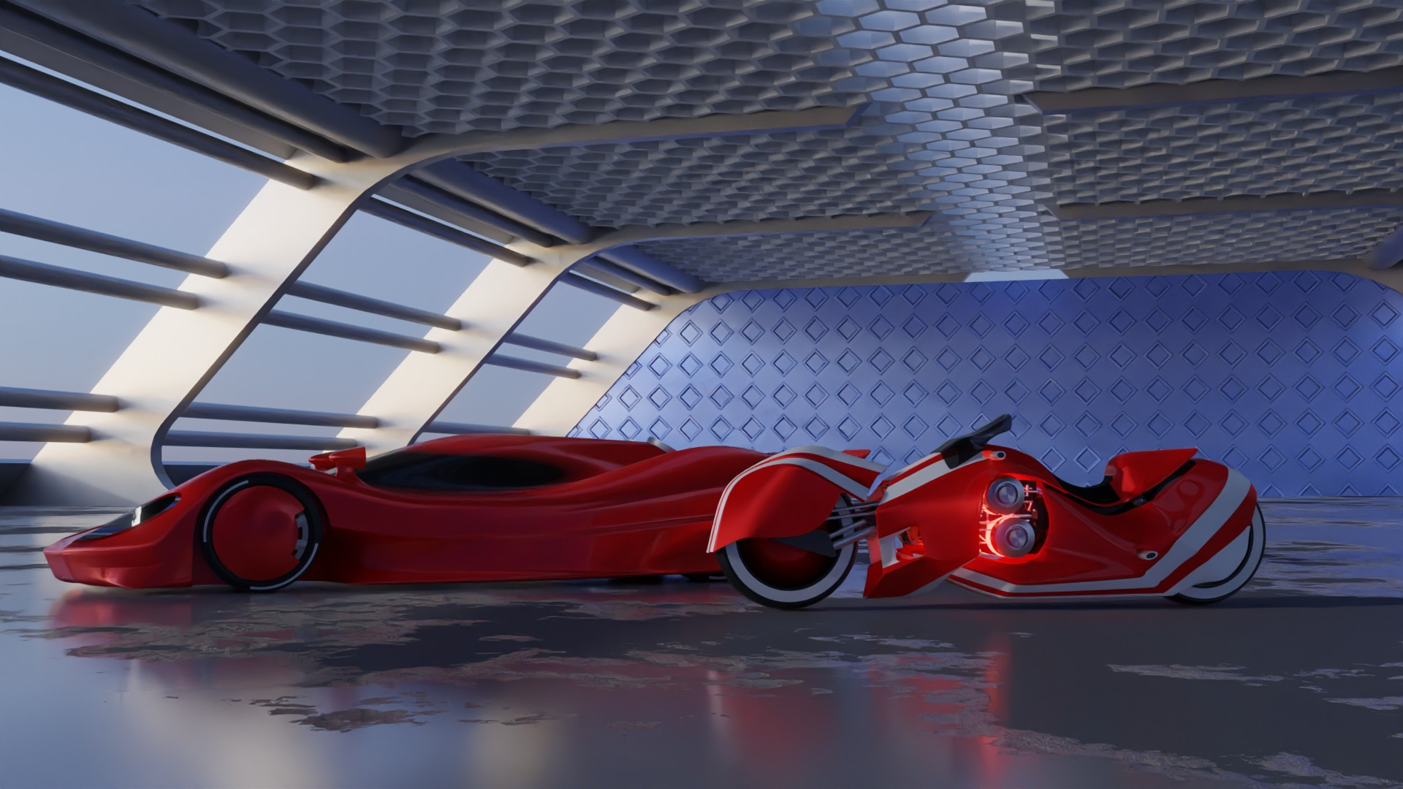

Slide 92
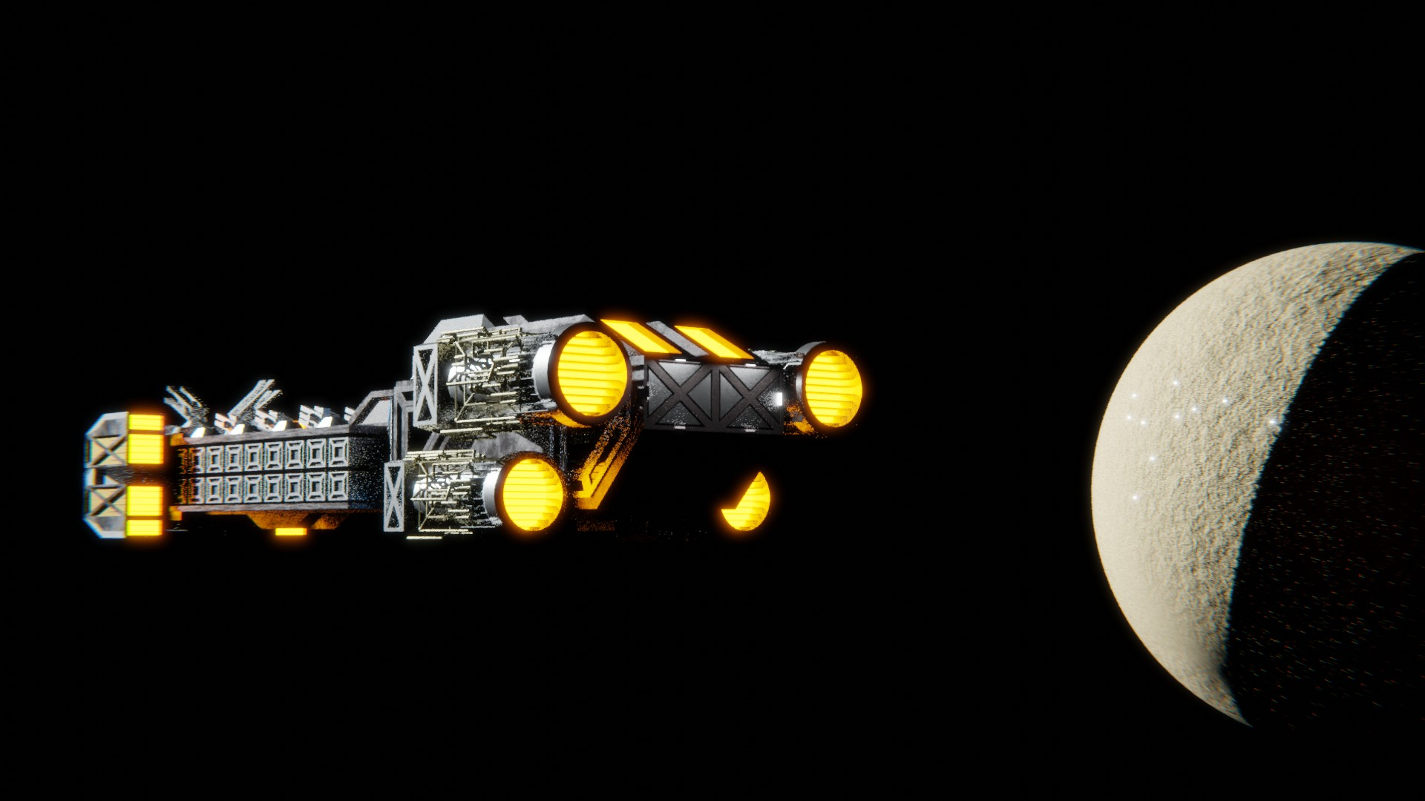

Slide 93
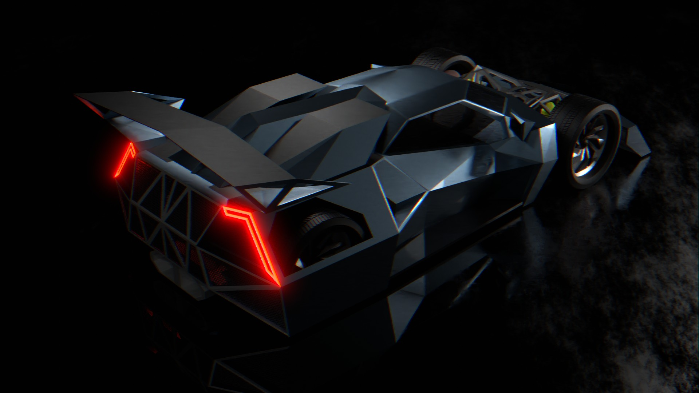

Slide 94

GDU-PICT showcase

Slide 95
GDU PICT Showcase

Slide 96


Slide 97
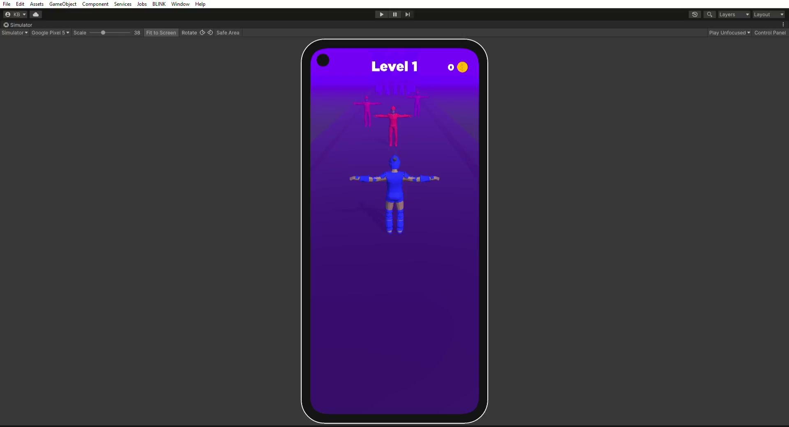

Slide 98
GDU IIIT-K Showcase

Slide 99
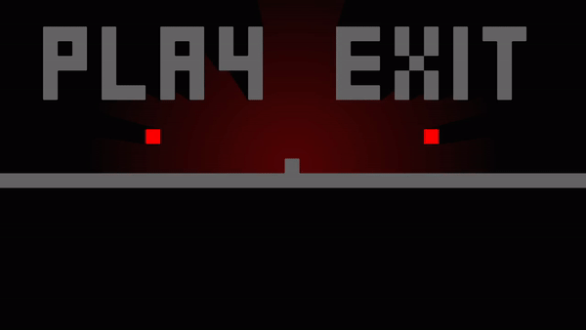
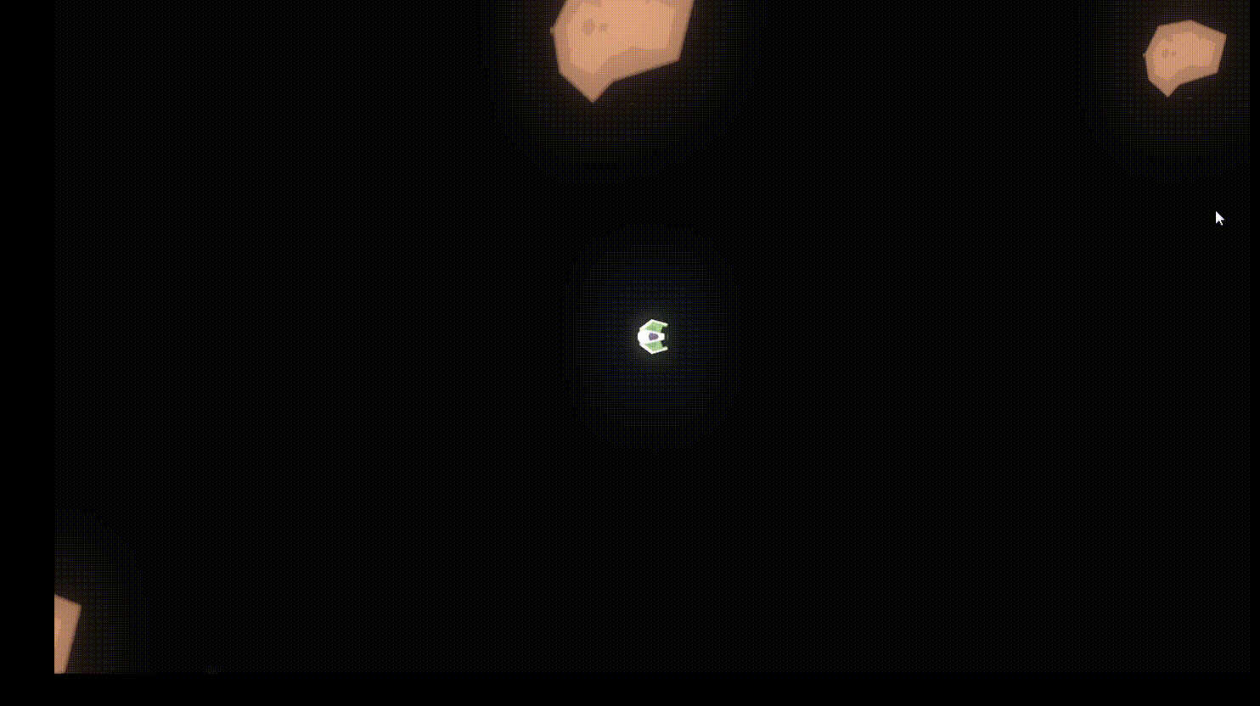
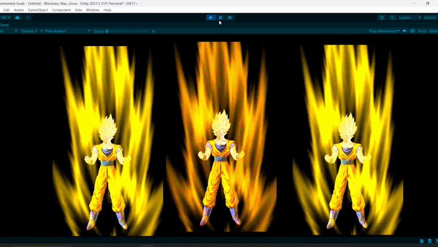

Slide 100




Contact Us

Slide 101
THANK YOU

